Slide 1
Linear Programming with lpSolve
and Introduction to Shiny
Chu Oguejiofor

Slide 2
Packages needed:
lpSolveAPI
Shiny
Rsconnect

Slide 3
Linear Programming Refresher

Slide 4
Linear Programming
A mathematical technique for maximizing or minimizing a linear function of several variables, such as output or cost.
Steps:
Write the objective function.
Write the constraints as a system of inequalities.
Find the set of feasible solutions that graphically represent the constraints.
Calculate the coordinates of the vertices from the compound of feasible solutions.

Slide 5
Example Problem
Lisa has an online jewelry shop where she sells earrings and necklaces. She sells earrings for $30 and necklaces for $40. It takes 30 minutes to make a pair of earrings and 1 hour to make a necklace, and, since Lisa is a math tutor, she only has 10 hours a week to make jewelry. In addition, she only has enough materials to make 15 total jewelry items per week. She makes a profit of $15 on each pair of earrings and $20 on each necklace. How many pairs of earrings and necklaces should Lisa make each week in order to maximize her profit, assuming she sells all her jewelry?
Objective Function:
Maximize 15x + 20y
Constraints:
.5x + y <= 10
x + y <= 10
x >= 0
y >= 0

Slide 6
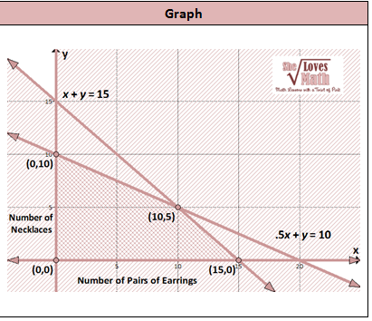
Graph
(0,0) -> 0
(15, 0) -> 225
(0,10) -> 200
(10,5) -> 250

Slide 7
LpSolveAPI

Slide 8
Functions
make.lp(# of constraints, # of decision variables)
Starts your linear program
set.objfn(linear program, c(x, y, ...)
Sets your objective function with coefficients x, y, ...
add.constraint(linear program, c(x, y, ...), “(in)equality”, z)
Adds a constraint with coefficients x, y, .. an sign (“=”, “<=”, “>=”, “>”...) and number “z”.
solve(linear program)
You must run this to get your answers
get.objective(linear program)
Gets you your maximized or minimized objective
get.variables(linear program)
Gets you your variables for your solution.

Slide 9
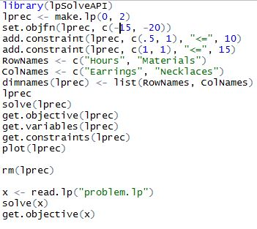
Demo
Open up linOpt.R

Slide 10
Shiny

Slide 11
Shiny
A
A web application framework for R
Allows you to run R code on a server and host apps or analyses in the cloud.
Not too difficult to write
No web development skills needed.
Well documented
Code is open source on GitHub

Slide 12
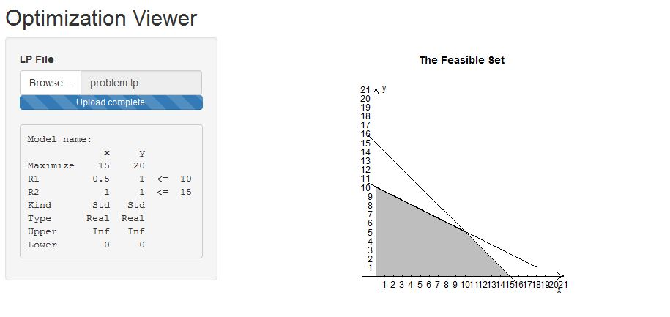
Demo
Open up server.R and ui.R

Slide 13
Deploying on shinyapps.io

